Slide 1


Slide 2

NATURAL LANGUAGE
PROCESSING
YELP
REVIEWS ANALYSIS

Slide 3
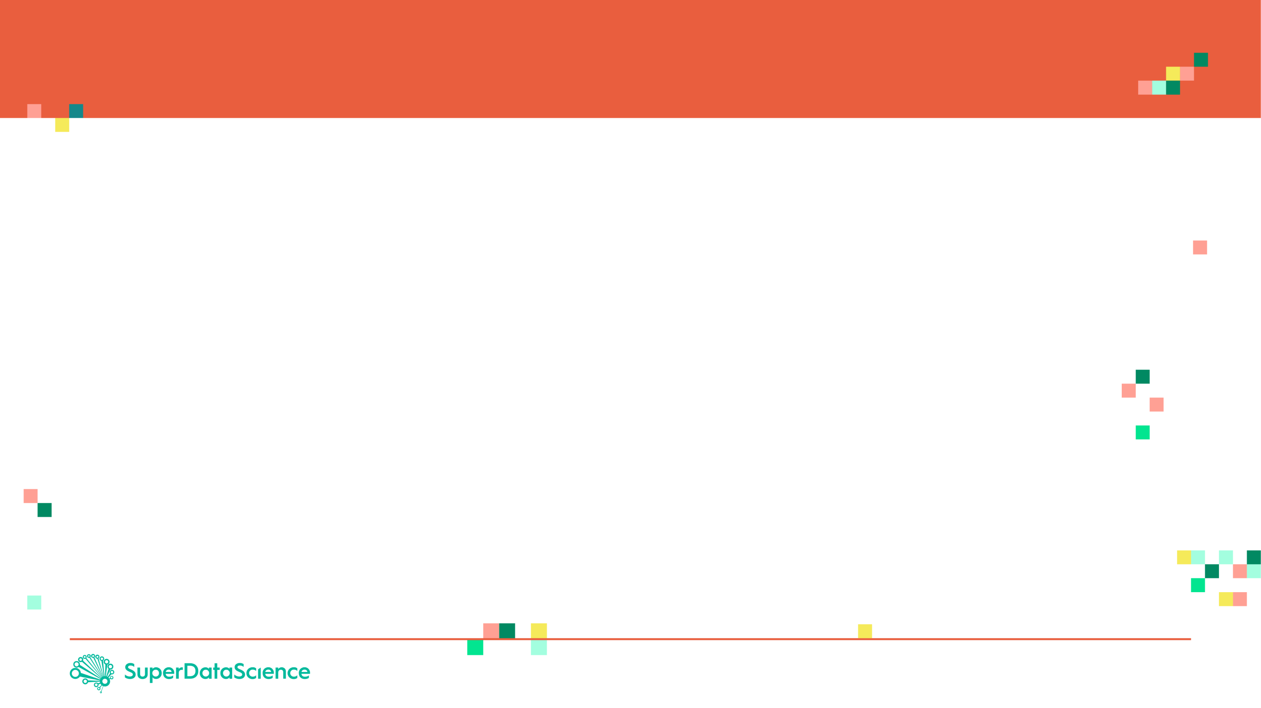

PROJECT OVERVIEW
In this project, Natural Language Processing (NLP) strategies will be used to analyze Yelp reviews data
Yelp is an app that provides a crowd-sourced review forum to business and services. The app is used publish crowd-sourced reviews about businesses.
Number of 'stars' indicate the business rating given by a customer, ranging from 1 to 5
'Cool', 'Useful' and 'Funny' indicate the number of cool votes given by other Yelp Users.
Photo Credit: https://commons.wikimedia.org/wiki/File:Yelp_Logo.svg

Slide 4
PROJECT OVERVIEW
After completing this section, students will be able to:
Learn the basics of Natural Language Processing.
Apply the Natural Language Toolkit or Nltk for short to perform tokenization
Apply feature extraction using Count Vectorizer.
Understand the theory behind naïve Bayes classifiers.
Understand the difference between Likelihood, prior probability and marginal likelihood.
Learn how to work with unbalanced dataset.
Train a Naïve Bayes classifier model using scikit learn.
Develop a function in python and apply it to pandas data frame
Photo Credit: https://commons.wikimedia.org/wiki/File:Yelp_Logo.svg

